Slide 1

Web Application Development
COMP-229
Fall 2023

Slide 2
React With JXS
The way we make things more efficient in our React applications is to use JSX.
JSX is a JavaScript extension that allows us to define React elements using syntax that looks similar to HTML. We are going to discuss how to use JSX to construct a React application.
React Elements as JSX Facebook’s React team released JSX when they released React to provide a concise syntax for creating complex DOM trees with attributes. They also hoped to make React more readable like HTML and XML. In JSX, an element’s type is specified with a tag.
The tag’s attributes represent the properties.
The element’s children can be added between the opening and closing tags. You can also add other JSX elements as children.

Slide 3
If you have an unordered list, you can add child list item elements to it with JSX tags. It looks very similar to HTML.
<ul> <li>1 lb Salmon</li> <li>1 cup Pine Nuts</li> <li>2 cups Butter Lettuce</li> <li>1 Yellow Squash</li> <li>1/2 cup Olive Oil</li> <li>3 Cloves of Garlic</li> </ul>

Slide 4
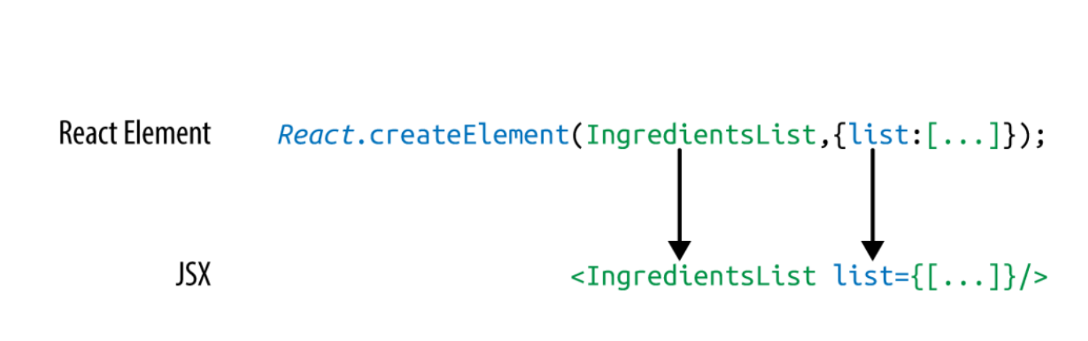
JSX works with components as well.
Simply define the component using the class name.
We pass an array of ingredients to the IngredientsList as a property with JSX.

Slide 5
When we pass the array of ingredients to this component, we need to surround it with curly braces. This is called a JavaScript expression, and we must use these when passing JavaScript values to components as properties.
Component properties will take two types:
either a string or a JavaScript expression.
JavaScript expressions can include arrays, objects, and even functions.
In order to include them, you must surround them in curly braces.

Slide 6
JSX Tips
JSX might look familiar, and most of the rules result in syntax that is similar to HTML.
However, there are a few considerations that you should understand when working with JSX.

Slide 7
NESTED COMPONENTS
JSX allows you to add components as children of other components.
For example, inside the IngredientsList, we can render another component called Ingredient multiple times:
<IngredientsList> <Ingredient /> <Ingredient /> <Ingredient /> </IngredientsList>

Slide 8
CLASSNAME
Since class is a reserved word in JavaScript, className is used to define the class attribute instead:
<h1 className="fancy">Baked Salmon</h1>

Slide 9
JAVASCRIPT EXPRESSIONS
JavaScript expressions are wrapped in curly braces and indicate where variables shall be evaluated and their resulting values returned.
For example, if we want to display the value of the title property in an element, we can insert that value using a JavaScript expression.
The variable will be evaluated and its value returned:

Slide 10
JAVASCRIPT EXPRESSIONS Contd.
<h1>{title}</h1>
Values of types other than string should also appear as JavaScript expressions:
<input type="checkbox" defaultChecked="{false}" />

Slide 11
EVALUATION
The JavaScript that is added in between the curly braces will get evaluated.
This means that operations such as concatenation or addition will occur.
This also means that functions found in JavaScript expressions will be invoked:
<h1>{"Hello" + title}</h1> <h1>{title.toLowerCase().replace}</h1> function appendTitle({ title }) { console.log(`${title} is great!`); }

Slide 12
Mapping Arrays with JSX
JSX is JavaScript, so you can incorporate JSX directly inside of JavaScript functions.
For example, you can map an array to JSX elements:
<ul> {props.ingredients.map((ingredient, i) => ( <li key="{i}">{ingredient}</li> ))} </ul>

Slide 13
JSX looks clean and readable, but it can’t be interpreted with a browser. All JSX must be converted into createElement calls or factories. There is an excellent tool for this task: Babel.

Slide 14
Babel
Many software languages require you to compile your source code.
JavaScript is an interpreted language: the browser interprets the code as text, so there is no need to compile JavaScript.
However, not all browsers support the latest JavaScript syntax, and no browser supports JSX syntax.
Since we want to use the latest features of JavaScript along with JSX, we are going to need a way to convert our fancy source code into something that the browser can interpret.
This process is called compiling, and it is what Babel is designed to do.

Slide 15
Babel contd.
The first version of the project was called 6to5, and it was released in September 2014.
6to5 was a tool that could be used to convert ES6 syntax to ES5 syntax, which was more widely supported by web browsers.
As the project grew, it aimed to be a platform to support all of the latest changes in ECMAScript.
It also grew to support converting JSX into JavaScript.
The project was renamed as Babel in February 2015.

Slide 16
Babel Contd.
Babel is used in production at Facebook, Netflix, PayPal, Airbnb, and more. Previously, Facebook had created a JSX transformer that was their standard, but it was soon retired in favor of Babel.
There are many ways of working with Babel.
The easiest way to get started is to include a link to the Babel CDN directly in your HTML, which will compile any code in script blocks that have a type of “text/babel”.
Babel will compile the source code on the client before running it. Although this may not be the best solution for production, it is a great way to get started with JSX.

Slide 17
Babel Contd.
<!DOCTYPE html> <html> <head> <meta charset="utf-8" /> <title>React Examples</title> </head> <body> <div id="root"></div> <!-- React Library & React DOM --> <script src="https://unpkg.com/react@16.8.6/umd/react.development.js"></script> <script src="https://unpkg.com/react-dom@16.8.6/umd/react- dom.development.js"></script> <script src="https://unpkg.com/@babel/standalone/babel.min.js"></script> <script type="text/babel"> // JSX code here. Or link to separate JavaScript file that contains JSX. </script> </body> </html>

Slide 18
Completed code
<!DOCTYPE html>
<html>
<head>
<meta charset="utf-8" />
<title>React Examples</title>
</head>
<body>
<div id="root">
<h1 className="fancy">Baked Salmon</h1>
<!--<h1>{title}</h1>-->
<h1>{"Hello" + title}</h1>
</div>
<!-- React Library & React DOM -->
<script
src="https://unpkg.com/react@16.8.6/umd/react.development.js"></script>
<script src="https://unpkg.com/react-dom@16.8.6/umd/react-
dom.development.js"></script>
<script
src="https://unpkg.com/@babel/standalone/babel.min.js"></script>
<script type="text/babel">
// JSX code here. Or link to separate JavaScript file that contains JSX.
React.createElement(IngredientsList, {list:
[<ul>
<li>1 lb Salmon</li>
<li>1 cup Pine Nuts</li>
<li>2 cups Butter Lettuce</li>
<li>1 Yellow Squash</li>
<li>1/2 cup Olive Oil</li>
<li>3 Cloves of Garlic</li>
</ul>
]});
<h1>{title.toLowerCase().replace}</h1>
function appendTitle({ title }) {
console.log(`${title} is great!`);
}
<ul>
{props.ingredients.map((ingredient, i) => (
<li key="{i}">{ingredient}</li>
))}
</ul>
</script>
</body>
</html>

Slide 19
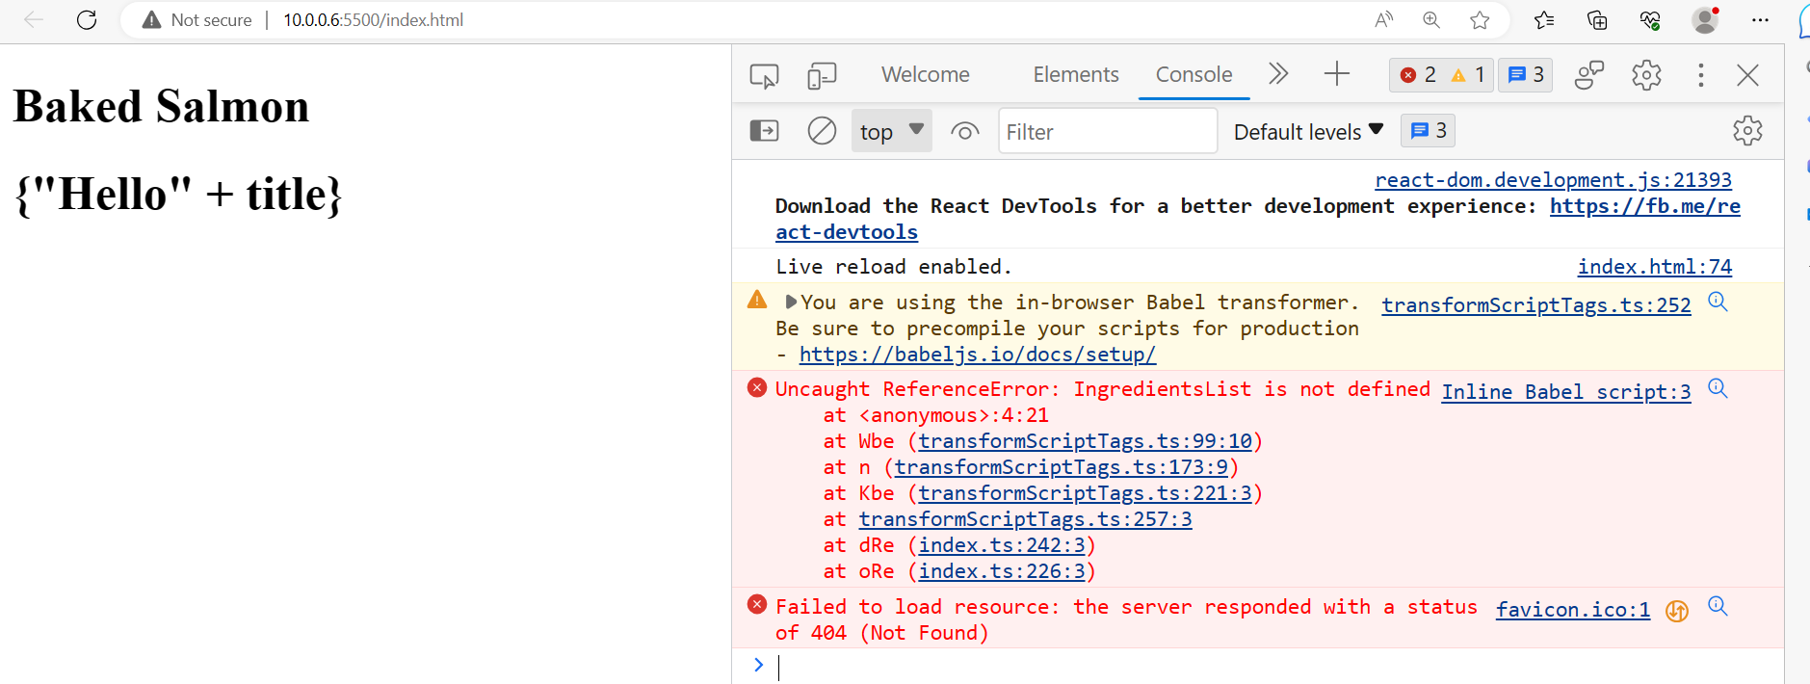
Output

Slide 20


Slide 21
Recipes as JSX
JSX provides us with a nice, clean way to express React elements in our code that makes sense to us and is immediately readable by developers.
The drawback of JSX is that it is not readable by the browser. Before our code can be interpreted by the browser, it needs to be converted from JSX into JavaScript.

Slide 22
This data array contains two recipes, and this represents our application’s current state:

Slide 23
const data = [
{
name: "Baked Salmon",
ingredients: [
{ name: "Salmon", amount: 1, measurement: "l lb" },
{ name: "Pine Nuts", amount: 1, measurement: "cup" },},
{
{ name: "Butter Lettuce", amount: 2, measurement: "cups" },
{ name: "Yellow Squash", amount: 1, measurement: "med" },
{ name: "Olive Oil", amount: 0.5, measurement: "cup" },
{ name: "Garlic", amount: 3, measurement: "cloves" }
],
steps: [
"Preheat the oven to 350 degrees.",
"Spread the olive oil around a glass baking dish.",
"Add the yellow squash and place in the oven for 30 mins.",
"Add the salmon, garlic, and pine nuts to the dish.",
"Bake for 15 minutes.",
"Remove from oven. Add the lettuce and serve."
]
name: "Fish Tacos",
ingredients: [
{ name: "Whitefish", amount: 1, measurement: "l lb" },
{ name: "Cheese", amount: 1, measurement: "cup" },
{ name: "Iceberg Lettuce", amount: 2, measurement: "cups" },
{ name: "Tomatoes", amount: 2, measurement: "large" },
{ name: "Tortillas", amount: 3, measurement: "med" }
],
steps: [
"Cook the fish on the grill until cooked through.",
"Place the fish on the 3 tortillas.",
"Top them with lettuce, tomatoes, and cheese."
]
}
];

Slide 24
The data is expressed in an array of two JavaScript objects.
Each object contains the name of the recipe, a list of the ingredients required, and a list of steps necessary to cook the recipe.
We can create a UI for these recipes with two components: a Menu component for listing the recipes and a Recipe component that describes the UI for each recipe.
It’s the Menu component that we will render to the DOM. We will pass our data to the Menu component as a property called recipes:

Slide 25
// The data, an array of Recipe objects
const data = [ ... ];
// A function component for an individual Recipe
function Recipe (props) {
...
}
// A function component for the Menu of Recipes
function Menu (props) {
...
}// A call to ReactDOM.render to render our Menu into the current DOM
ReactDOM.render(
<Menu recipes={data} title="Delicious Recipes" />,
document.getElementById("root")
);

Slide 26
The React elements within the Menu component are expressed as JSX.
Everything is contained within an article element. A header element, an h1 element, and a div.recipes element are used to describe the DOM for our menu.
The value for the title property will be displayed as text within the h1:

Slide 27
function Menu(props) {
return (
<article>
<header>
<h1>{props.title}</h1>
</header>
<div className="recipes" />
</article>
);
}

Slide 28
Inside of the div.recipes element, we add a component for each recipe:
<div className="recipes">
{props.recipes.map((recipe, i) => (
<Recipe
key={i}
name={recipe.name}
ingredients={recipe.ingredients}
steps={recipe.steps}
/>
))}
</div>

Slide 29
In order to list the recipes within the div.recipes element, we use curly braces to add a JavaScript expression that will return an array of children.
We can use the map function on the props.recipes array to return a component for each object within the array.
As mentioned previously, each recipe contains a name, some ingredients, and cooking instructions (steps).
We will need to pass this data to each Recipe as props. Also remember that we should use the key property to uniquely identify each element.

Slide 30
You could also refactor this to use spread syntax. The JSX spread operator works like the object spread operator.
It will add each field of the recipe object as a property of the Recipe component. The syntax here will supply all properties to the component:
{
props.recipes.map((recipe, i) => <Recipe key={i} {...recipe} />);
}

Slide 31
Remember that this shortcut will provide all of the properties to the Recipe component.
This could be a good thing but might also add too many properties to the component.
Another place we can make a syntax improvement to our Menu component is where we take in the props argument.
We can use object destructuring to scope the variables to this function.
This allows us to access the title and recipes variables directly, no longer having to prefix them with props:

Slide 32
function Menu({ title, recipes }) {
return (
<article>
<header>
<h1>{title}</h1>
</header>
<div className="recipes">
{recipes.map((recipe, i) => (
<Recipe key={i} {...recipe} />
))}
</div>
</article>
);
}
Now let’s code the component for each individual recipe:
function Recipe({ name, ingredients, steps }) {
return (
<section id={name.toLowerCase().replace(/ /g, "-")}>
<h1>{name}</h1>
<ul className="ingredients">
{ingredients.map((ingredient, i) => (
<li key={i}>{ingredient.name}</li>
))}
</ul>
<section className="instructions">
<h2>Cooking Instructions</h2>
{steps.map((step, i) => (
<p key={i}>{step}</p>
))}
</section>
</section>
);
}

Slide 33
Each recipe has a string for the name, an array of objects for ingredients, and an array of strings for the steps.
Using object destructuring, we can tell this component to locally scope those fields by name so we can access them directly without having to use props.name, or props.ingredients, props.steps.

Slide 34
The first JavaScript expression that we see is being used to set the id attribute for the
root section element. It is converting the recipe’s name to a lowercase string and globally
replacing spaces with dashes. The result is that “Baked Salmon” will be converted to “baked-
salmon” (and likewise, if we had a recipe with the name “Boston Baked Beans” it would be
converted to “boston-baked-beans”) before it is used as the id attribute in our UI. The value
for name is also being displayed in an h1 as a text node.

Slide 35
Inside of the unordered list, a JavaScript expression is mapping each ingredient to an li element
that displays the name of the ingredient. Within our instructions section, we see the same pattern
being used to return a paragraph element where each step is displayed. These map functions are
returning arrays of child elements.
The complete code for the application should look like this:

Slide 36
<!DOCTYPE html>
<html>
<head>
<meta charset="utf-8" />
<title>React Examples</title>
</head>
<body>
<div id="root"></div>
<!-- React Library & React DOM -->
<script
src="https://unpkg.com/react@16.8.6/umd/react.development.js"></script>
<script src="https://unpkg.com/react-dom@16.8.6/umd/react-
dom.development.js"></script>
<script
src="https://unpkg.com/@babel/standalone/babel.min.js"></script>
<script type="text/babel">
// JSX code here. Or link to separate JavaScript file that contains JSX.
const data = [
{
name: "Baked Salmon",
ingredients: [
{ name: "Salmon", amount: 1, measurement: "l lb" },
{ name: "Pine Nuts", amount: 1, measurement: "cup" },
{ name: "Butter Lettuce", amount: 2, measurement: "cups" },
{ name: "Yellow Squash", amount: 1, measurement: "med" },
{ name: "Olive Oil", amount: 0.5, measurement: "cup" },
{ name: "Garlic", amount: 3, measurement: "cloves" }
],
steps: [
"Preheat the oven to 350 degrees.",
"Spread the olive oil around a glass baking dish.",
"Add the yellow squash and place in the oven for 30 mins.",
"Add the salmon, garlic, and pine nuts to the dish.",
"Bake for 15 minutes.",
"Remove from oven. Add the lettuce and serve."
]

Slide 37
},
{
name: "Fish Tacos",
ingredients: [
{ name: "Whitefish", amount: 1, measurement: "l lb" },
{ name: "Cheese", amount: 1, measurement: "cup" },
{ name: "Iceberg Lettuce", amount: 2, measurement: "cups" },
{ name: "Tomatoes", amount: 2, measurement: "large" },
{ name: "Tortillas", amount: 3, measurement: "med" }
],
steps: [
"Cook the fish on the grill until hot.",
"Place the fish on the 3 tortillas.",
"Top them with lettuce, tomatoes, and cheese."
]
}
];function Recipe({ name, ingredients, steps }) {
return (
<section id={name.toLowerCase().replace(/ /g, "-")}>
<h1>{name}</h1>
<ul className="ingredients">
{ingredients.map((ingredient, i) => (
<li key={i}>{ingredient.name}</li>
))}
</ul>
<section className="instructions">
<h2>Cooking Instructions</h2>
{steps.map((step, i) => (
<p key={i}>{step}</p>
))}
</section>
</section>
);

Slide 38
}
function Menu({ title, recipes }) {
return (
<article>
<header>
<h1>{title}</h1>
</header>
<div className="recipes">
{recipes.map((recipe, i) => (
<Recipe key={i} {...recipe} />
))}
</div>
</article>
);
}
ReactDOM.render(
<Menu recipes={data} title="Delicious Recipes" />,
document.getElementById("root")
);
</script>
</body>
</html>

Slide 39
When we run this code in the browser, React will construct a UI using our instructions with the
recipe data as shown:

Slide 40
